Slide 1

ITI
Introduction to Computer Networks & Cyber Security Prepared By : Mohamed AboSehly

Slide 2
Part 2 (Cyber Security Essentials)
Cyber Security Essentials

Slide 3
Part 2 (Cyber Security Essentials)
Session Outlines
Information Security Goals
Confidentiality ,Integrity, Availability
Risks & Threats
Threats & Vulnerabilities
Attackers methodology & Methods
Malware Types
Security Defenses
Firewalls (Static & Dynamic firewalls)
IDS /IPS
VPN
Proxy
Next generation Firewalls
Encryption
Symmetric & Asymmetric Key Cryptography
Digital Signatures /Digital Certificates

Slide 4
Part2_ Attack Mitigation
Hardware
Firewalls
DMZ
IDS/IPS
NGFW
Software
Anti-virus
Anti-spam
Anti-malware
Security Patches
User Access Control

Slide 5
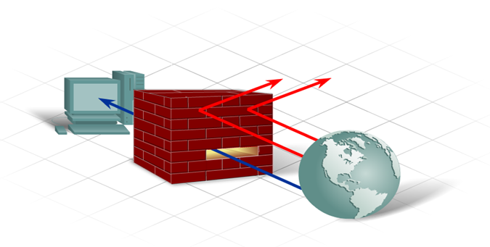
Part 2 _ Firewall
A Firewall is one of the most effective security tools available for protecting internal network users from external threats As the first line of defense
A firewall resides between two or more networks and controls the traffic between them as well as helps prevent unauthorized access
A firewall can be software-based or hardware-based
Static Packet Filtering (stateless firewall )
- Prevents or allows access based on IP or MAC addresses.
Dynamic Packet Filtering (state full firewall)
Incoming packets must be legitimate responses to requests from internal hosts. filter out specific types of attacks such as DoS

Slide 6
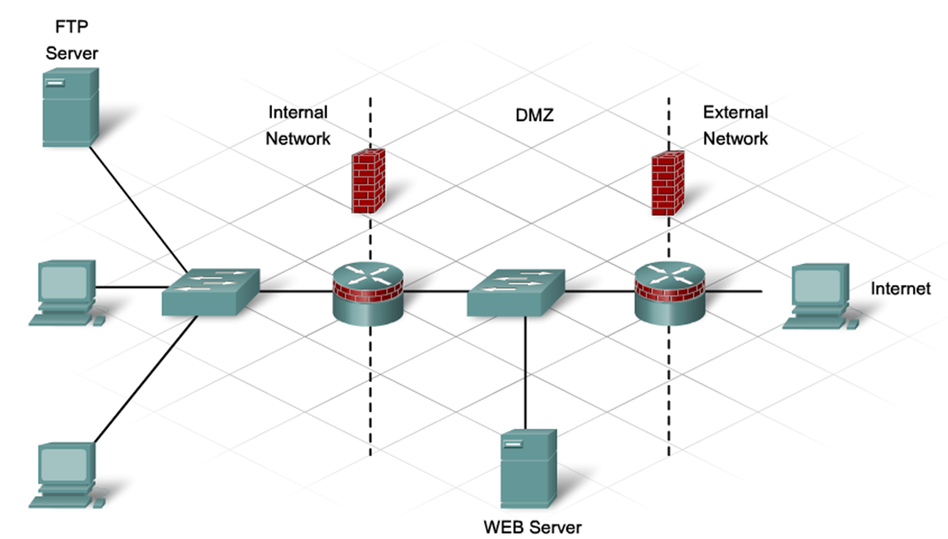
Part 2 _Firewall

Slide 7
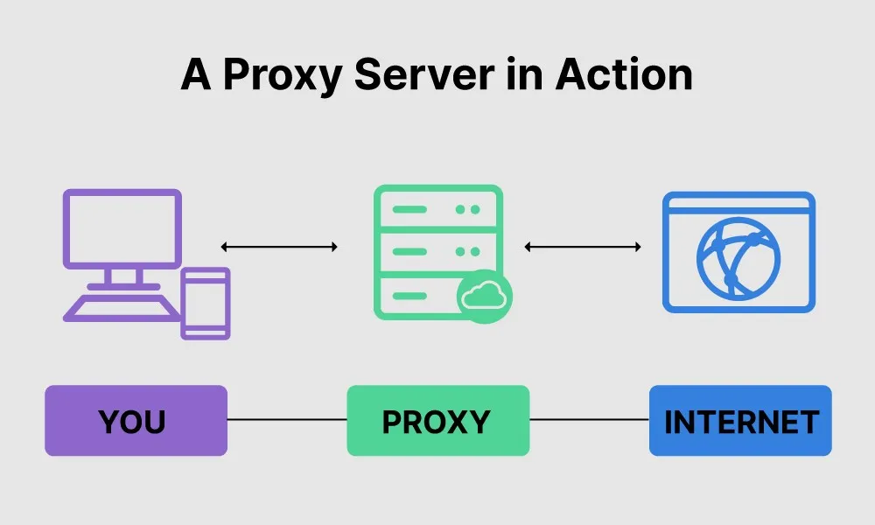
Part 2 _ Proxy Server
A computer system (or an application program) that intercepts internal user requests and then processes that request on behalf of the user
Goal is to hide the IP address of client systems inside the secure network

Slide 8
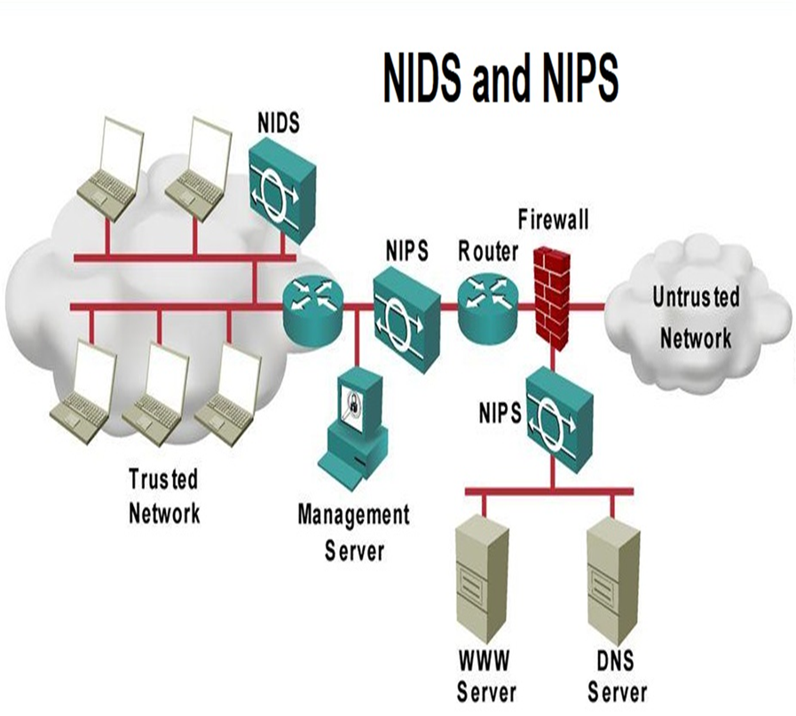
Part 2_ IDS/IPS
Network Intrusion Detection System (NIDS):
Watch the Network Traffic and if there is Intrusion it Detects that there is Bad traffic Flow.
it send alarms and logs
Network Intrusion prevention System (NIPS):
Stops the traffic if it detects that there is intrusion
Types of IDS&IPS
Signature-based: look for the perfect match
Anomaly-based: Built a based line of what is normal
Behavior-based: observe and report
Notes:
Intrusion:
Exploit against the Operating System, Applications, Buffer overflow and other vulnerabililites

Slide 9
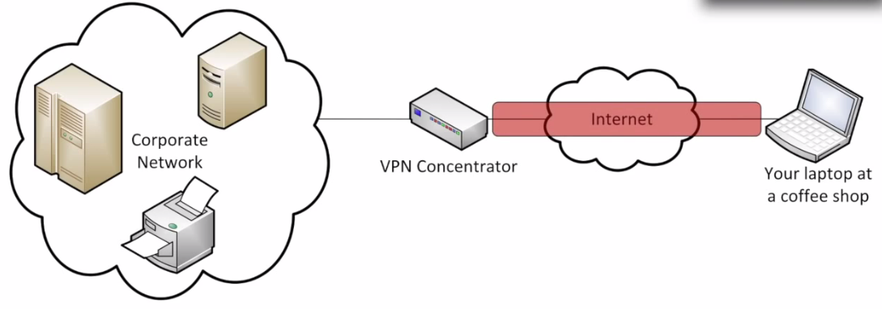
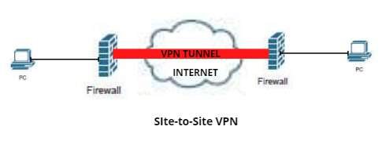
VPN
It Tunnel the traffic between the Two Sides of Network
Types:
Remote Access VPN
Site to Site VPN

Slide 10
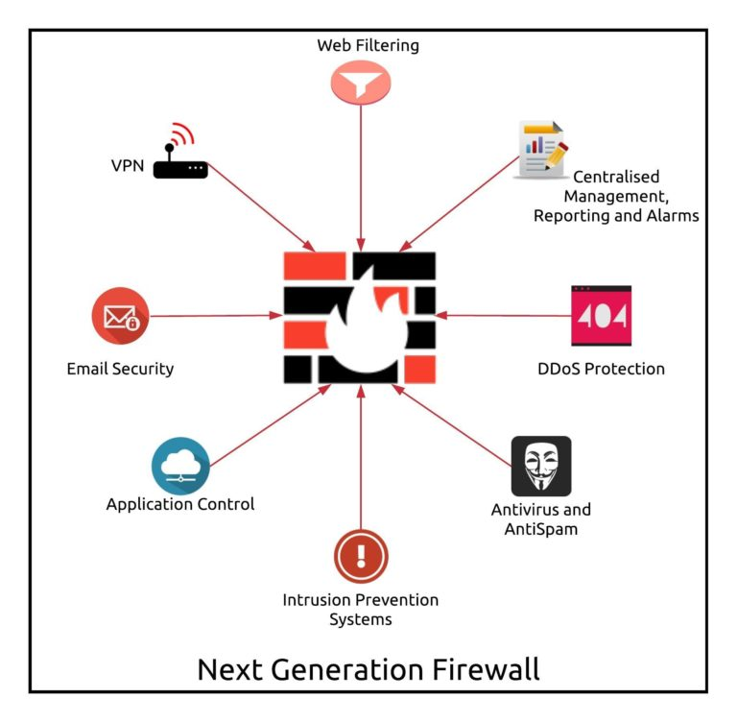
Part 2 _ Next generation Firewall (NGFW)
Next generation Firewall (NGFW)
a “deep-packet inspection firewall that moves beyond port/protocol inspection and blocking to add application-level inspection, intrusion prevention, and bringing intelligence from outside the firewall.”

Slide 11
Part 2 _Wireless Security
Open Access
SSID
No encryption
Basic authentication
Not a security handle
WEP
No strong authentication
Static, breakable keys
Not scalable
WPA
Improved encryption
Strong, user-based authentication
WPA2
AES Encryption
Authentication

Slide 12
Part 2_Controlling Wireless LAN Access
SSID broadcasts from access points are off
MAC Address filtering is enabled
WPA2 / WPA3 Security implemented

Slide 13
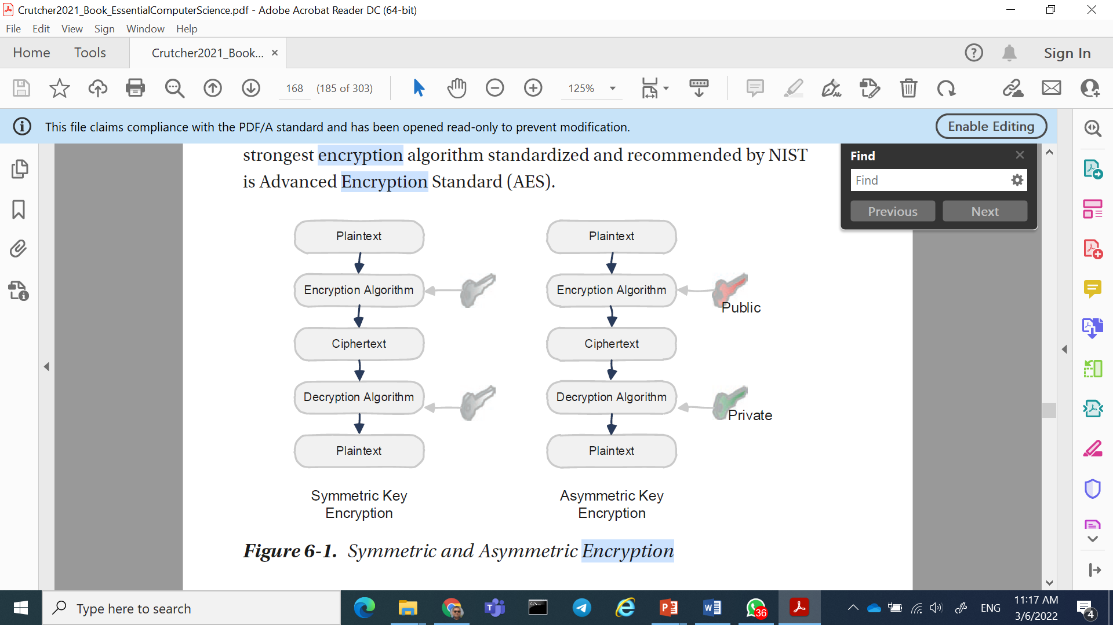
Part 2_ Encryption
Encryption
encryption is the process of encoding information. This process converts the original representation of the information, known as plaintext, into an alternative form known as ciphertext.
Unencrypted data, called plaintext, is sent through an encryption algorithm to generate a ciphertext. A key is used for encryption.
in a symmetric encryption algorithm, the same key is also used for decryption. (Not secure) needs to be a secure way for the two sides to have the same key

Slide 14
Part 2 (Digital Signatures & Certificates)
Digital Signatures
A digital signature is done by hashing a document and then encrypting the hash with a private key.
Any entity (like a bank) that has the public key can verify that the document is signed by the owner of the private key.
digital signatures do not provide confidentiality but only provide nonrepudiation and integrity.
Digital Certificates (public-key certificate)
electronic file that contains identification information about the holder, including the person’s public key (used for encrypting and decrypting messages), along with the authority’s digital signature,
the recipient can verify with the authority that the certificate is authentic.
Digital certificates are issued by certification authorities.
Websites usually also have digital certificates, to enable a person intending to buy its products to confirm that it is an authenticated site. Such certificates serve as the security basis for HTTPS

Slide 15
Part2 lab Practices
How to use your local firewall to block a port and stop DOS attack from a zombie device

Slide 16
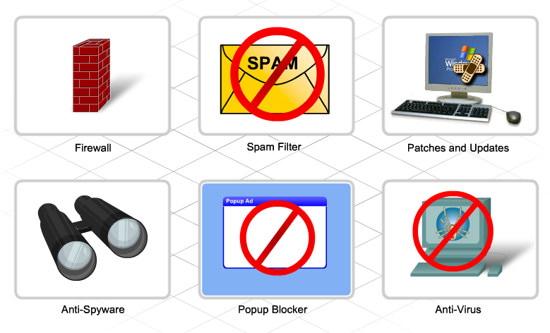
Best Practices
Network Security
Define security policies
Physically secure servers and network equipment
Set login and file access permissions
Update OS and applications
Change permissive default settings
Run anti-virus and anti-spyware
Update antivirus software files
Activate browser tools –
Popup stoppers, anti-phishing, plug-in monitors
Use a firewall

Slide 17
Thank You

